Slide 1
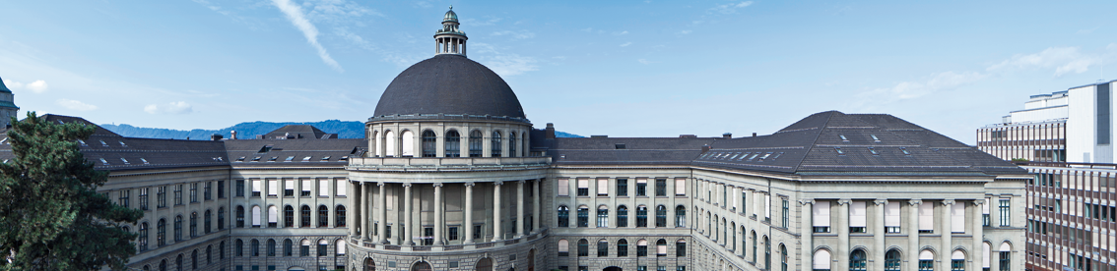
Development of a Monte Carlo algorithm for optimal control problems
Semester thesis by Stefano Weidmann,
supervised by Prof. Patrick Jenny, Taha Koltukluoglu and Prof. Ralf Hiptmair

Slide 2
What?

Slide 3
Measurements

Slide 4
Optimal control

Slide 5
Optimal control discretized

Slide 6
Optimal control discretized

Slide 7
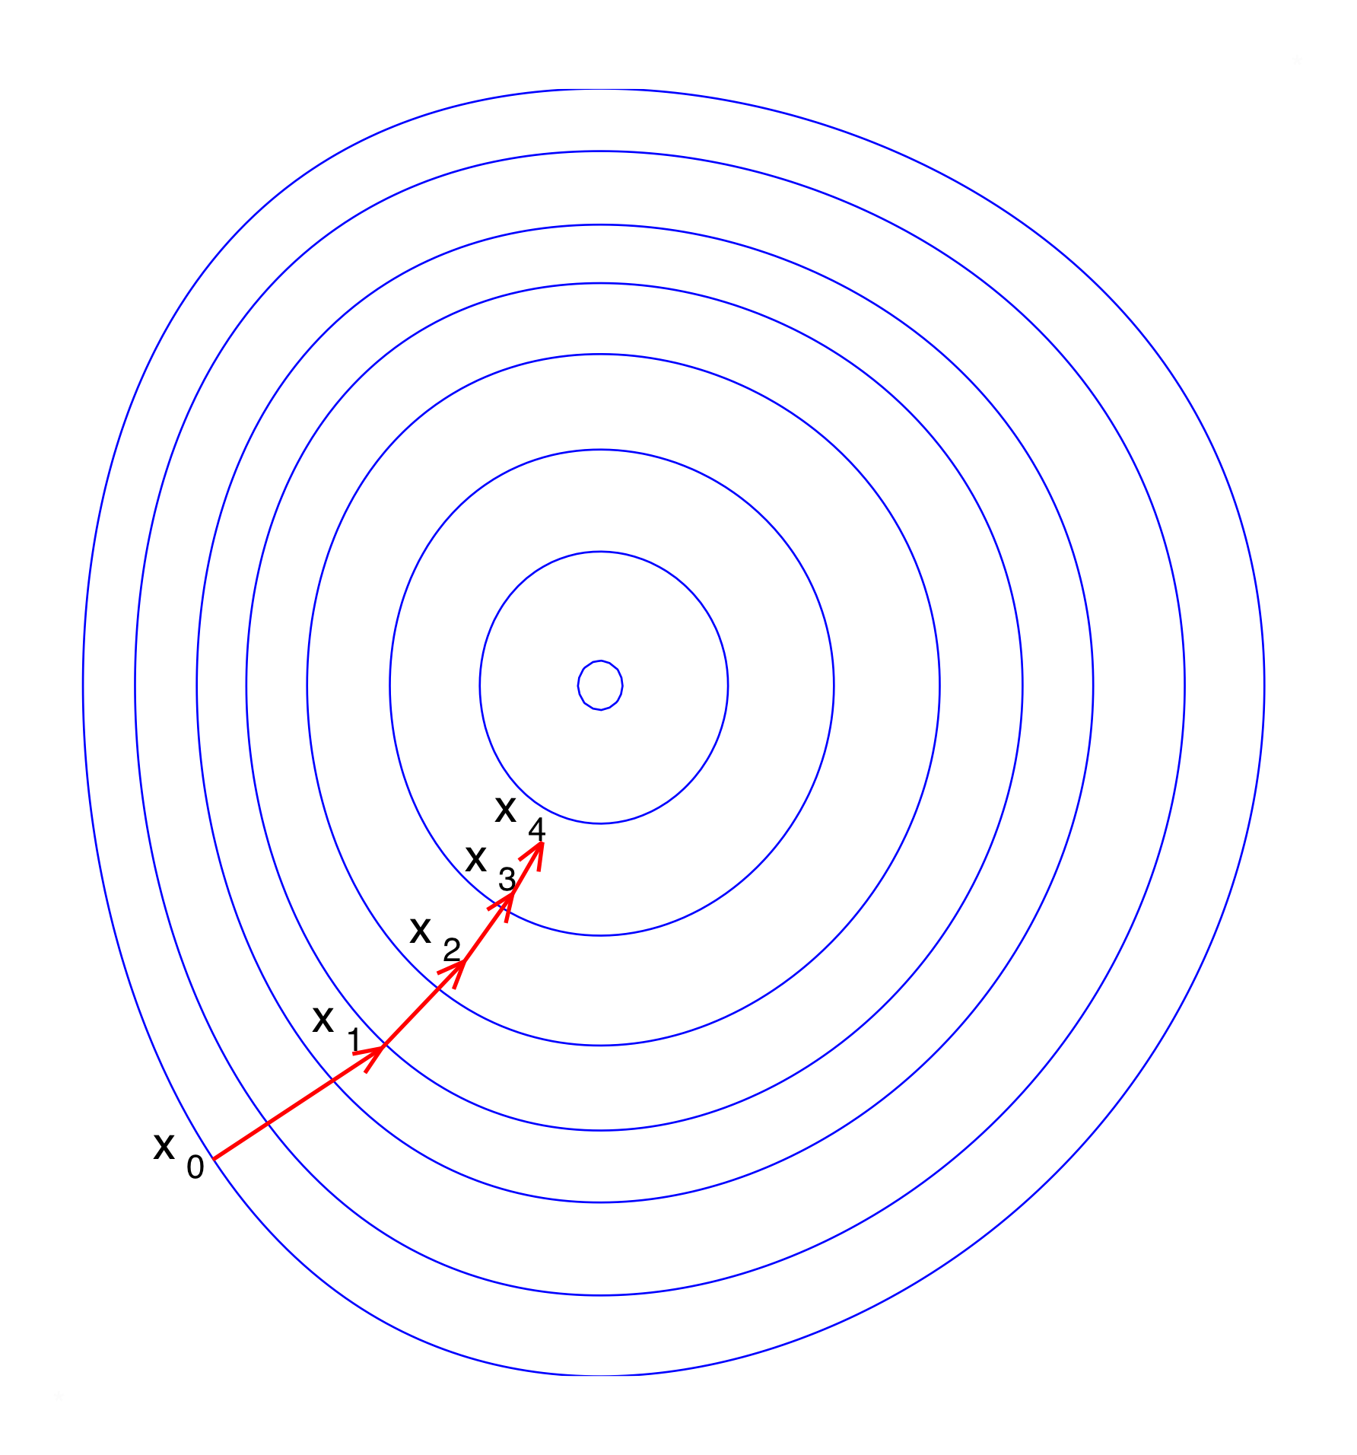
Goal
Image in public domain: https://commons.wikimedia.org/wiki/File:Gradient_descent.svg

Slide 8
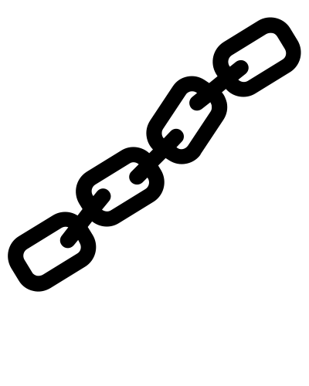
Chain image from Chain by Adrien Coquet from the Noun Project CC0

Slide 9
Chain image from Chain by Adrien Coquet from the Noun Project CC0

